Slide 1
Mackie Cricket Club
Survey RESULTS - SEASON 2018-2019

Slide 2
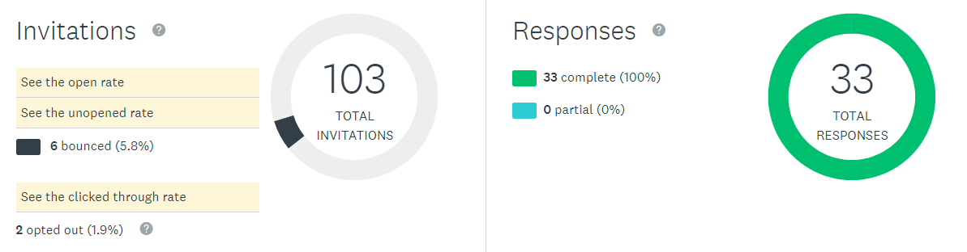
SURVEY ONE - Mackie CC Seniors End of Season Assessment 2019

Slide 3
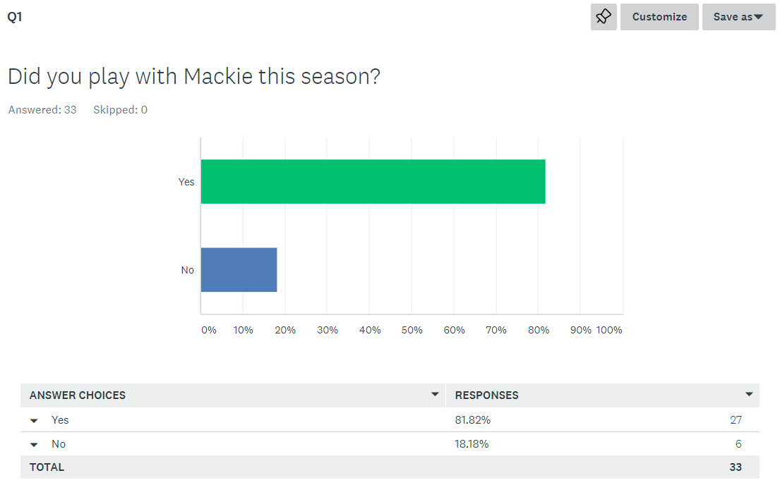

Slide 4
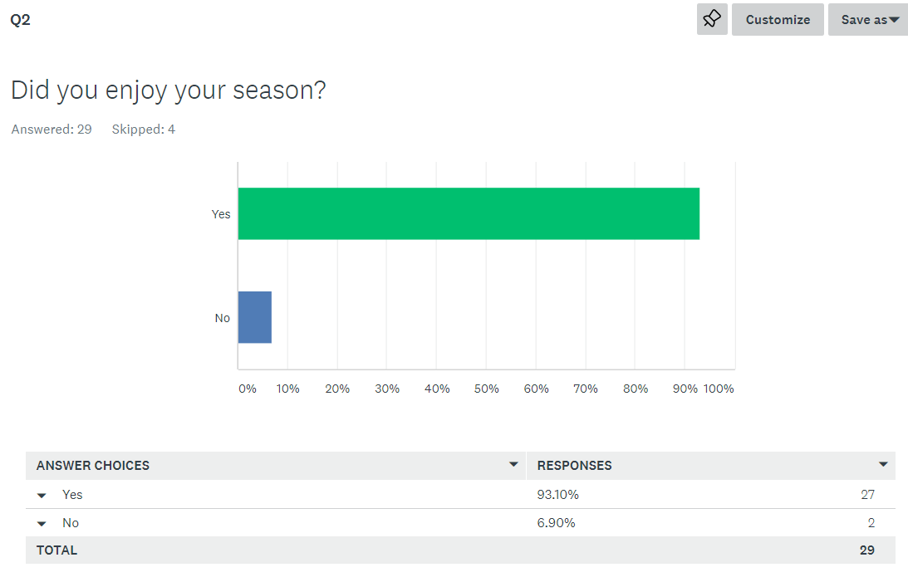

Slide 5
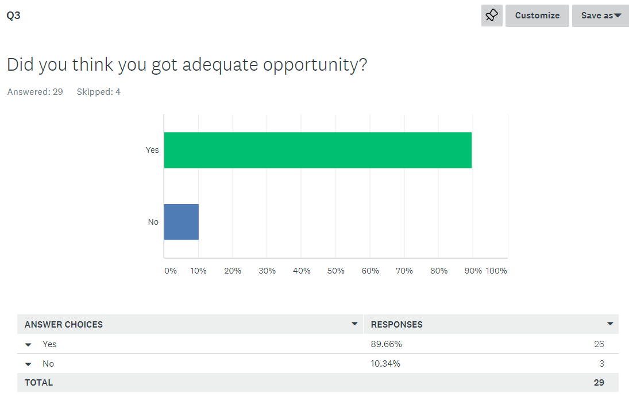

Slide 6
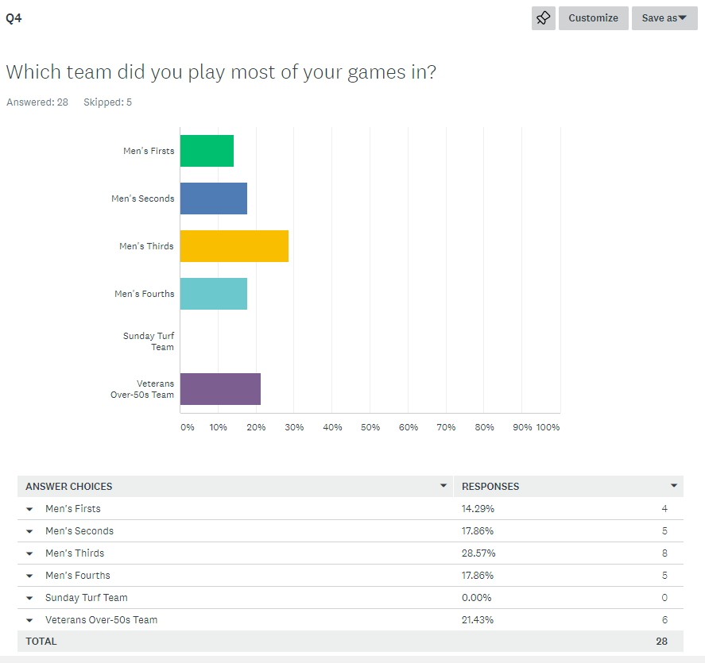

Slide 7
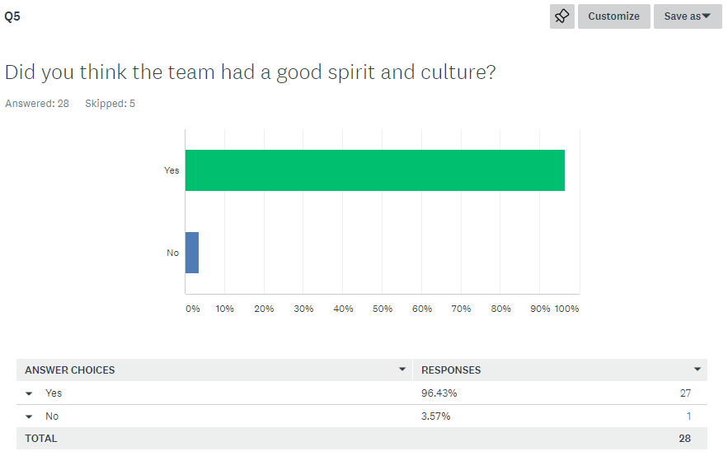

Slide 8
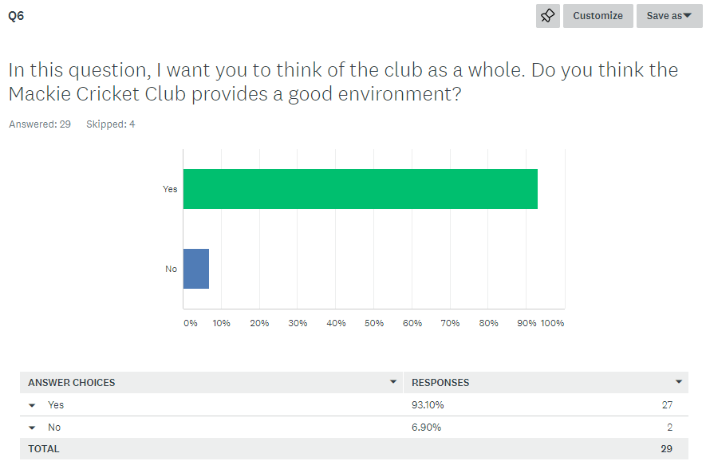

Slide 9
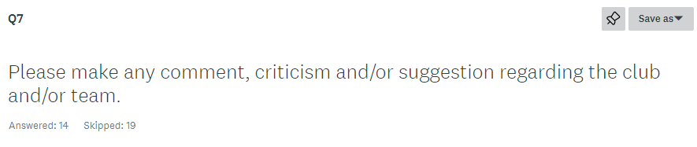
1. Constant changes in people playing each week makes it hard to get consistency.
2. Appears greater effort has been placed on Sunday and over 50 sides. The club is about Saturday cricket, and appears to be tired. the 5ths were removed and the 4ths had difficulty in getting a side. the social room has become a mess and store room, hopefully not these coming weekends when hosting finals. it appears selling alcohol has become important, doesn't look good having the group of regulars drinking through senior training sessions, while kids are still around. with the intention of the SECA rule change next year, the club is in a difficult position with SECA planned sunday games. What gives, being a member club of SECA, or member club of over 50 and one day grade association.
3. I believe the past players need more communication of happening events. This will create a better environment and help support the club as a whole. A lot of news is heard via second hand and well after the fact.

Slide 10
4. Lots of work to be done in regard to culture, branding and promotion. Especially senior club promotion through social media.
5. We need to market the club and recruit players and get back to the 5 teams we had last year. With a new playing/coach will bring new ideas and get back to what it was a few years ago.
6. Somehow get lower grade players to enjoy the club culture. Maybe get suggestions from them about what would get them to the club
7. very welcoming
8. The club like all things just needs to look at ways to improve to make things better and more inclusive for everyone
9. Great club, awesome people and very welcoming. Thanks for letting me roll the arm over :)
10. Needs to get more people involved

Slide 11
11. I think the club needs to identify where it’s fallen down in regards to lack of playing numbers. For those that attend training and play get the best out of themselves and if there is lack of interest from some of the playing group, then next season will prove to be even worse for numbers. We saw that when numbers were strong the top three teams all could win games or at least be competitive in their respective grades, the lack of numbers has shown that now 2nds and 3rds will drop a grade as a result of poor performance and not enforced by the league, cricket should be about providing commitment to the club in the summer and not play when you feel like it. The volunteers have done a fantastic job this season and this is under no scrutiny of them. The lack of numbers I feel will not help in the recruitment of numbers and talent to the club in future seasons.
12. The player list needs to be looked at to see how many games each player has played in the last 2/3 seasons. This way we can determine what grades should be applied for next season. Also take into account players age. The guys around 50 years of age would prefer to play limited overs I imagine.
13. Need chief selector or 2 to have an overall selection view. Core of team to be kept same and not move around
14. It will be great to be part of the same team through out the season instead of shuffling around. Also, maybe putting players in the team that might be more suitable for rather than simply "fill the spots“

Slide 12
Survey One - Conclusions
1. Responses came from all 4 senior teams plus veterans, none from turf team
2. About 93% enjoyed playing with the club
3. About 90% got adequate opportunity, 10% didn’t
4. About 96% thought their team had a good spirit and culture
5. Over 90% thought Mackie was a good environment
6. The club can improve further, taking respondent comments into consideration

Slide 13
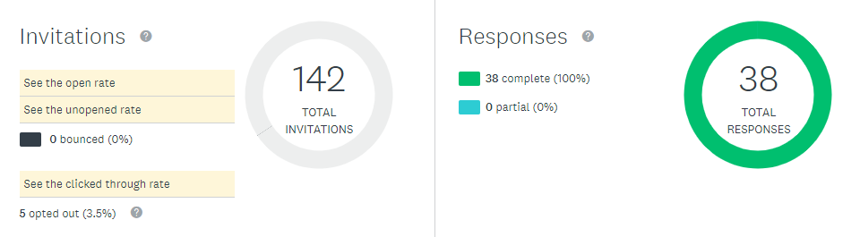
Survey Two - Mackie Cricket Club Strategic Survey

Slide 14
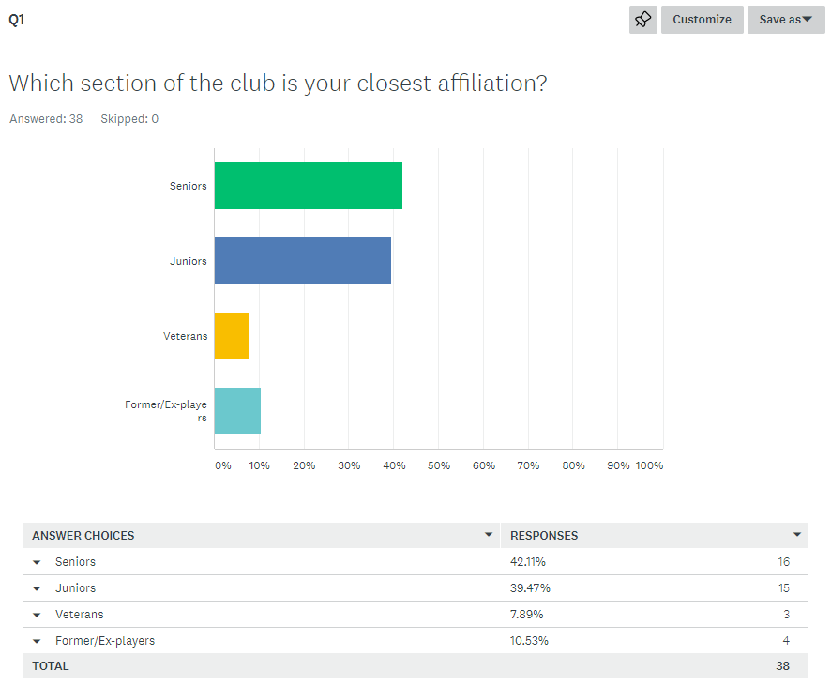

Slide 15
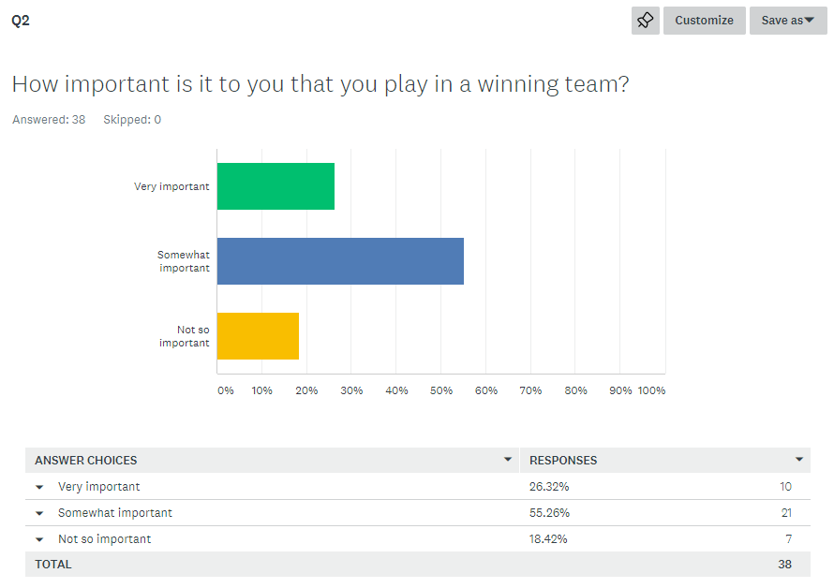

Slide 16
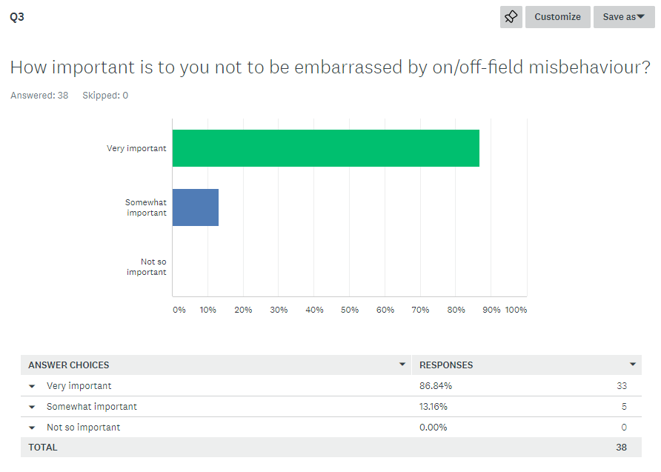

Slide 17
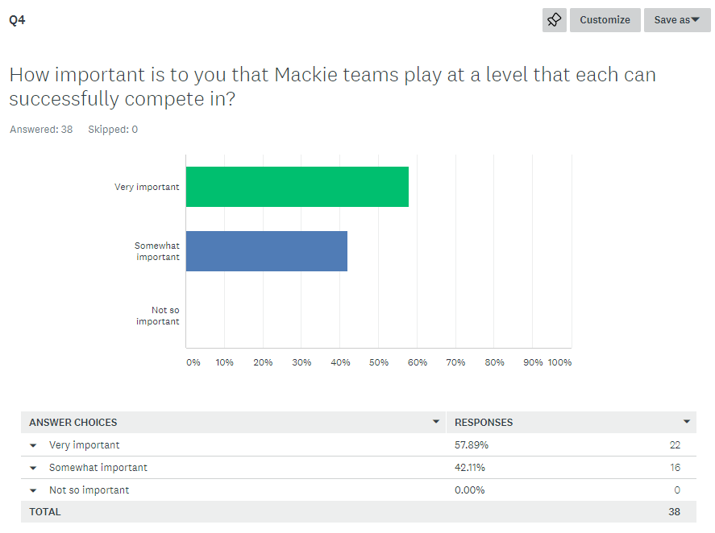

Slide 18
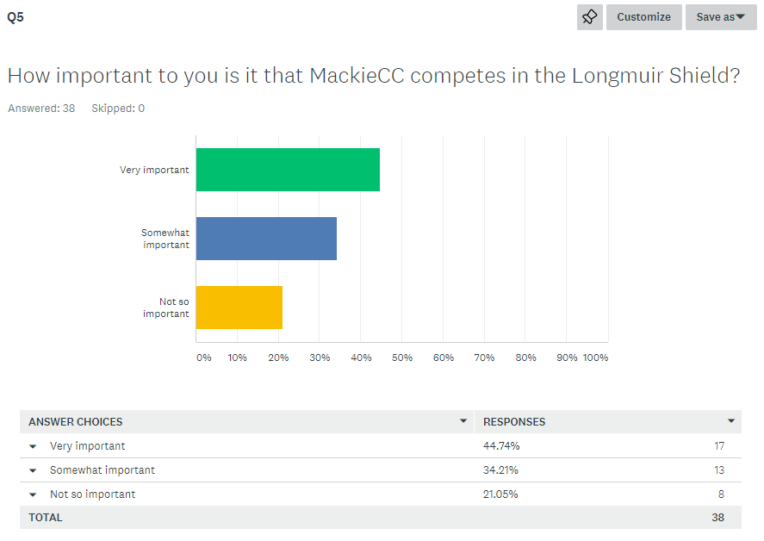

Slide 19
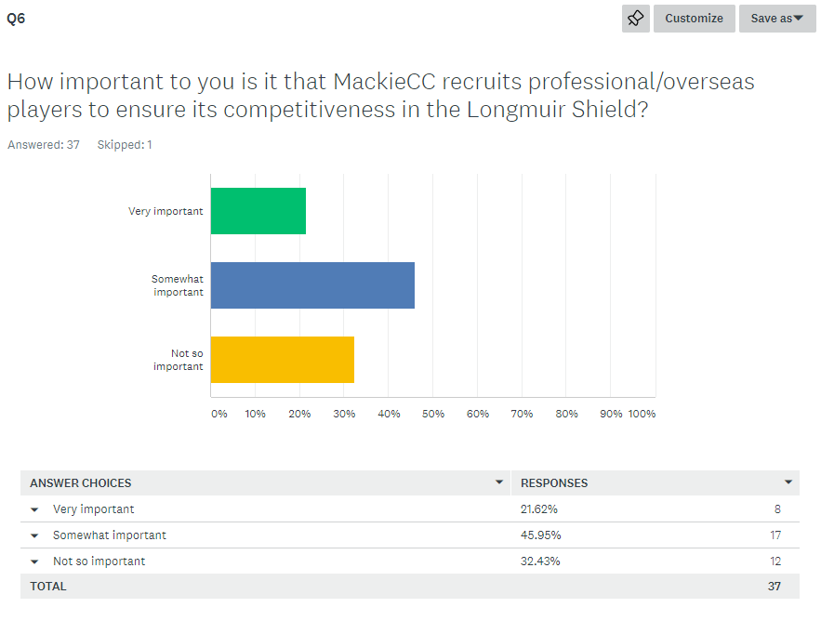

Slide 20
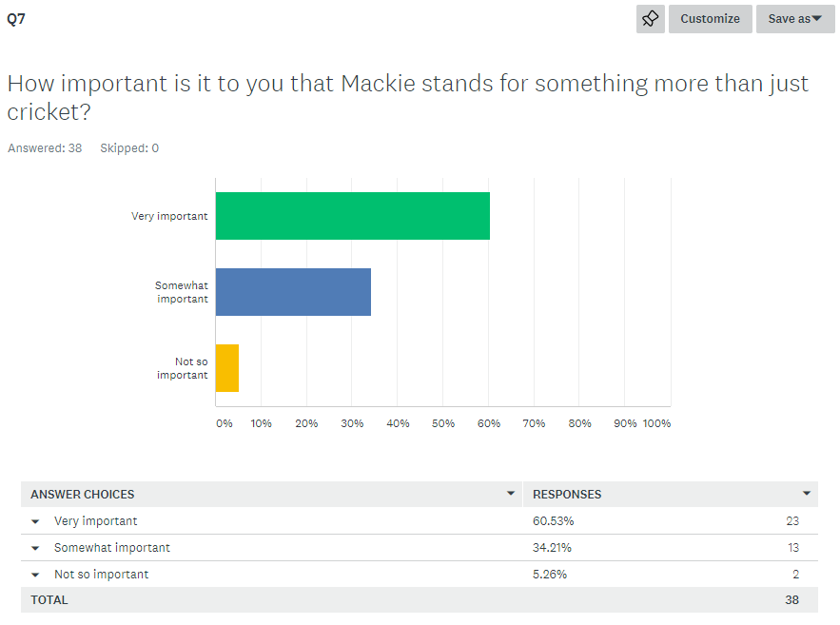

Slide 21


Slide 22
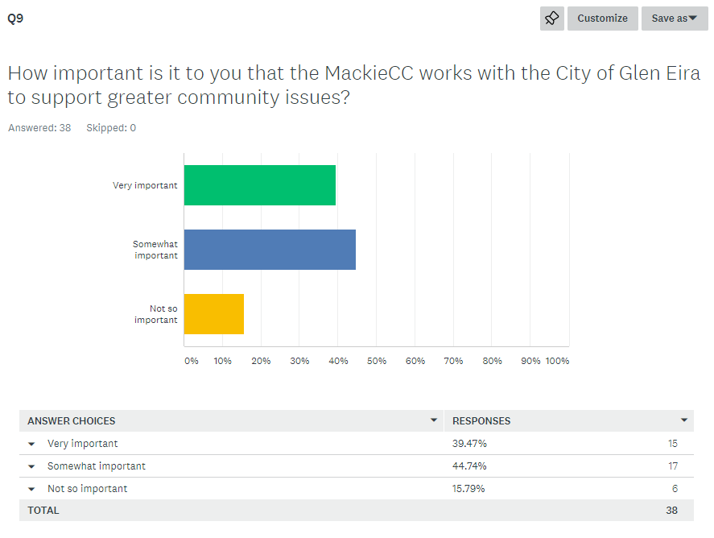

Slide 23
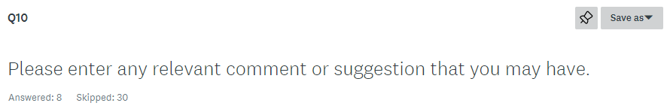
1. Mackie CC needs to recruit and advertise heavily for the new season, on Facebook, have a big board on Mackie Rd, instagram, local paper, whatever it takes to Market out Club.
2. Not sure if the employment of overseas players is a necessary expense - don’t appropriate people live in Australia (Melbourne). It would have been good to know what sort of things the club stand for may have affected my response. With regard to kids game - I believe they should be competitive experiencing wins and losses. And spectators should be just that spectators.
3. I feel The question about embarrassment on/off the field is a loaded question. Of course its important Do not use this question to make the club sterile and introduce wanky code of conduct etc.
4. Consult some players before hiring a new coach. Release the results of surveys like this for everyone to see otherwise they are useless.

Slide 24
5. Would like to see the club have more general fitness activities for both players and their families
6. I think its important to have more participation from existing players to come back to club after games and have a catch up even for 10 minutes to discuss the play, Keep the club rooms clean, Make sure training is structured and starts on time
7. Mackie is a great club and we are proud that our two boys play junior cricket in an inclusive environment with great coaches. I'd like to see a greater team effort in keeping the club rooms presentable, and that parents do not drink alcohol and smoke around children. This is not common but it does happen.
8. Good community PR. Maybe working with other clubs to create community based players

Slide 25
Survey Two - Conclusions
1. Responses came from each of the four groups – senior, junior, veterans & ex/former players
2. Playing in a winning team is important, but not most important
3. Mis-behaviour on/off-field does have repercussions on rest of team
4. Mackie teams must play in grades where they have a reasonable chance of success
5. Competing in Longmuir is important, but not most important
6. Professional / overseas players is not considered important amongst members
7. Members want have pride in club for more than just cricket
8. Members would like Mackie to work with City of Glen Eira to promote community leadership

